Slide 2
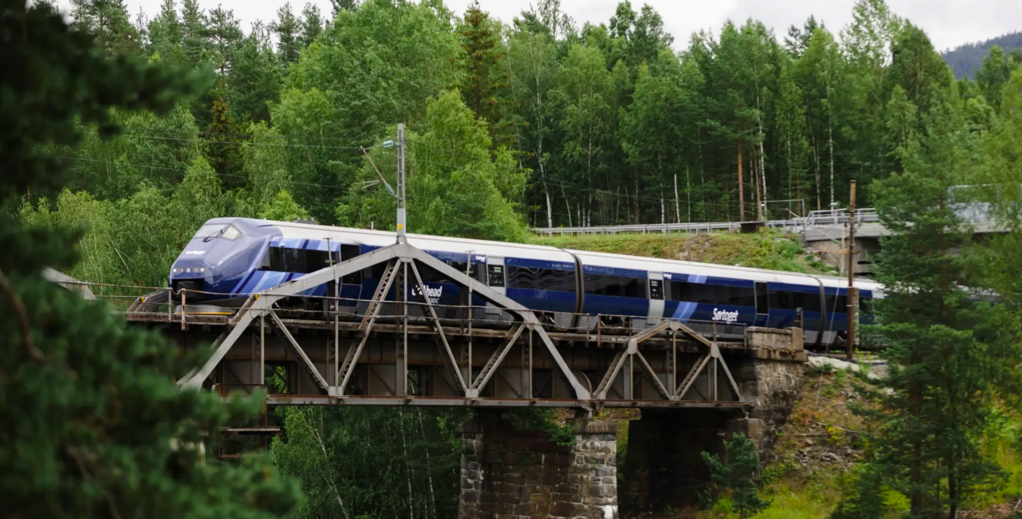

This talk
Notes:
Bettering some part of society? And doing so with gleam

Slide 3
This talk

Slide 4
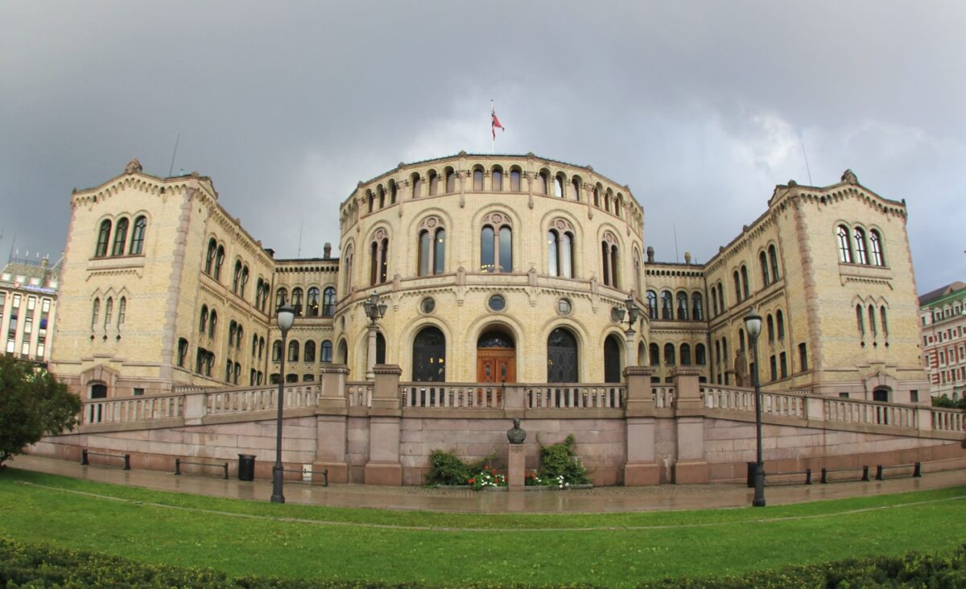

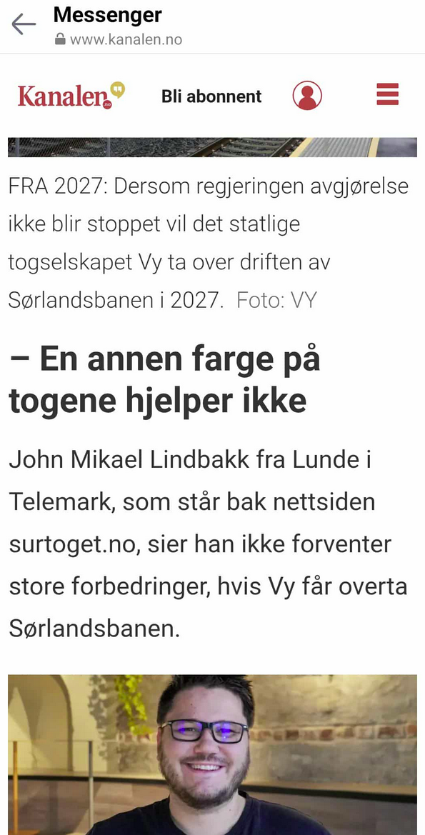

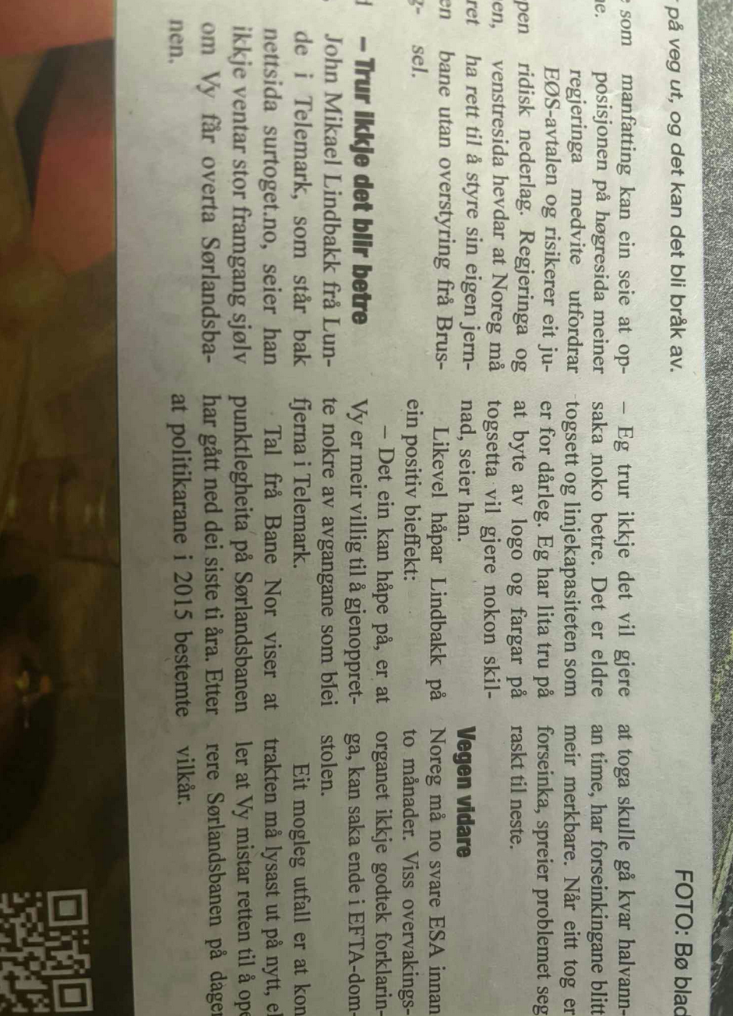
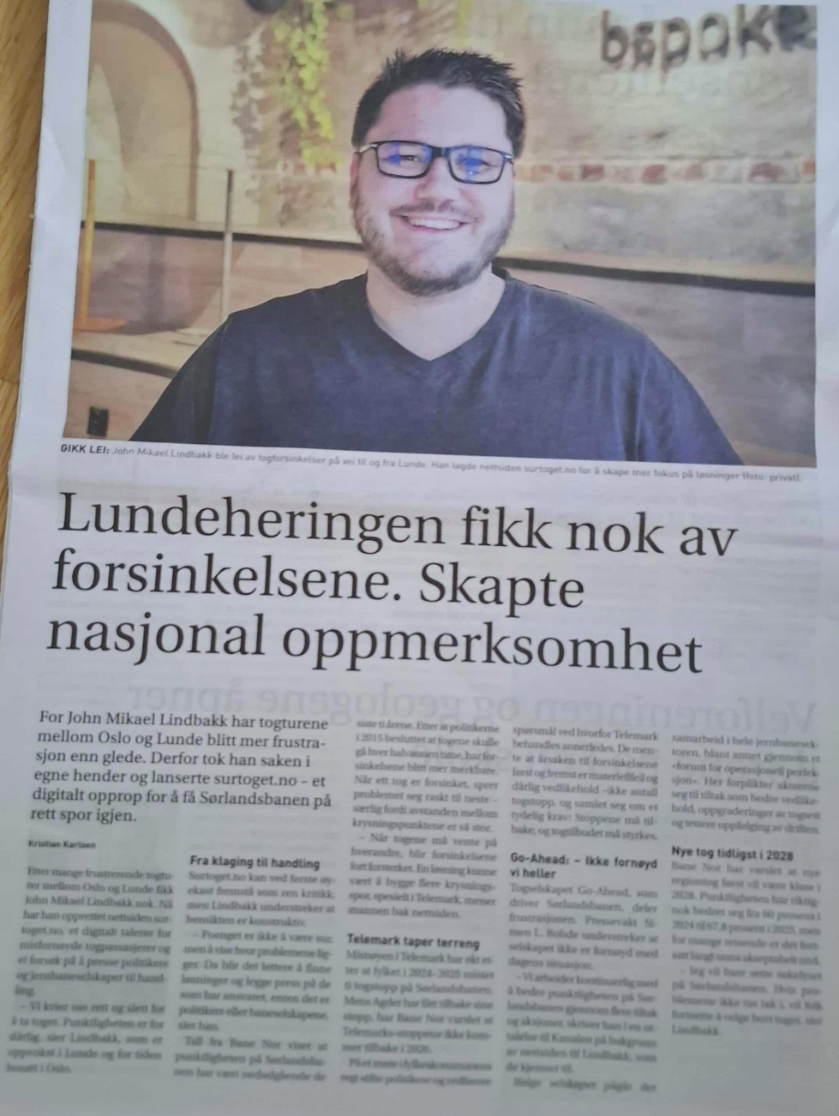

Slide 5
But what is a Sørlandsbanen anyway?

Slide 6
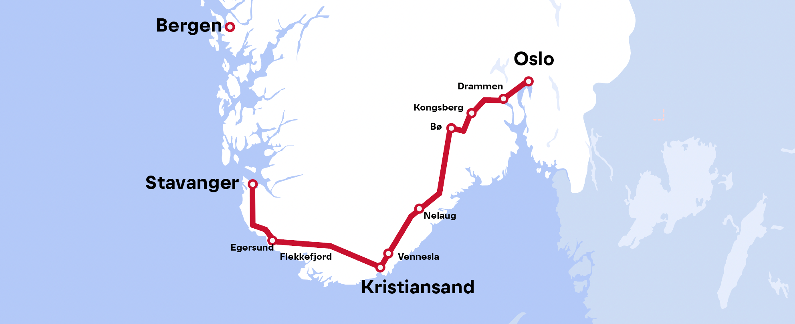
But what is a Sørlandsbanen anyway?
Lunde

Slide 7
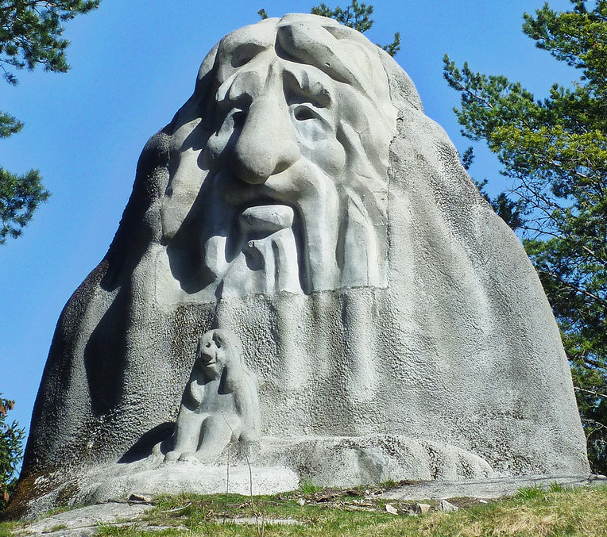
But what is a Sørlandsbanen anyway?
Lunde

Slide 8

But what is a Sørlandsbanen anyway?
Lunde

Slide 9
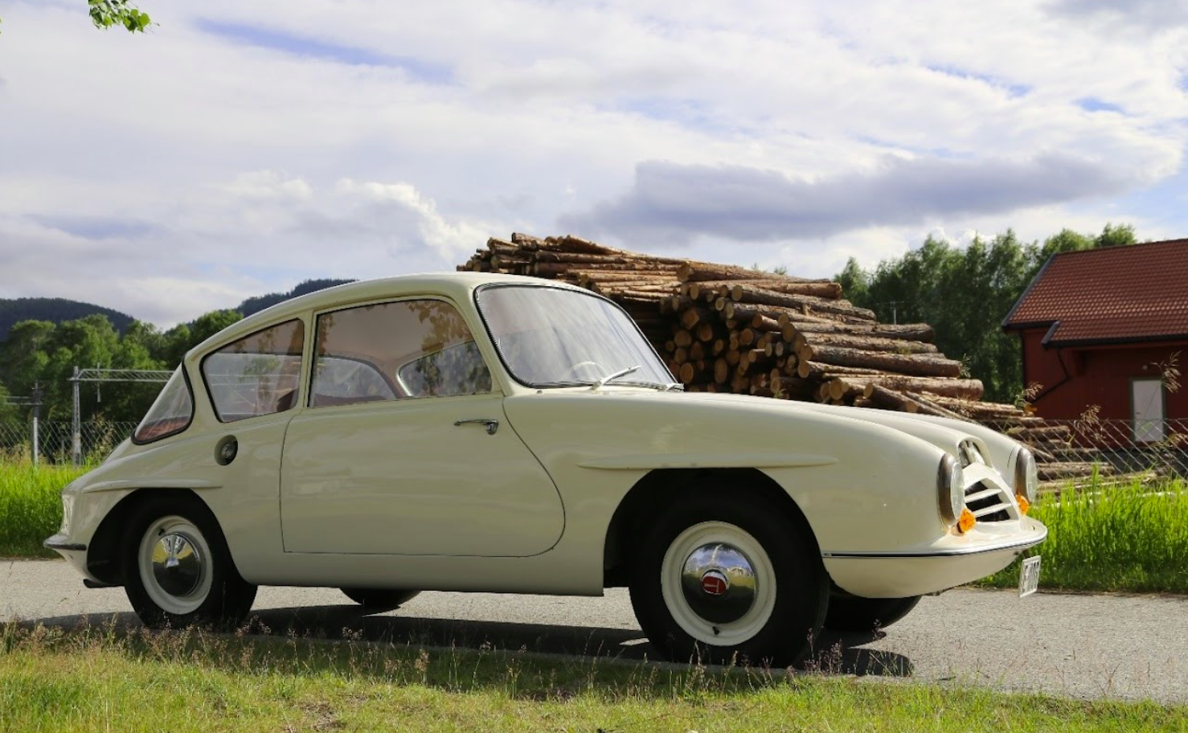
But what is a Sørlandsbanen anyway?
Lunde

Slide 10

But what is a Sørlandsbanen anyway?
Lunde

Slide 11

But what is a Sørlandsbanen anyway?
Lunde

Slide 12

But what is a Sørlandsbanen anyway?
Lunde

Slide 13
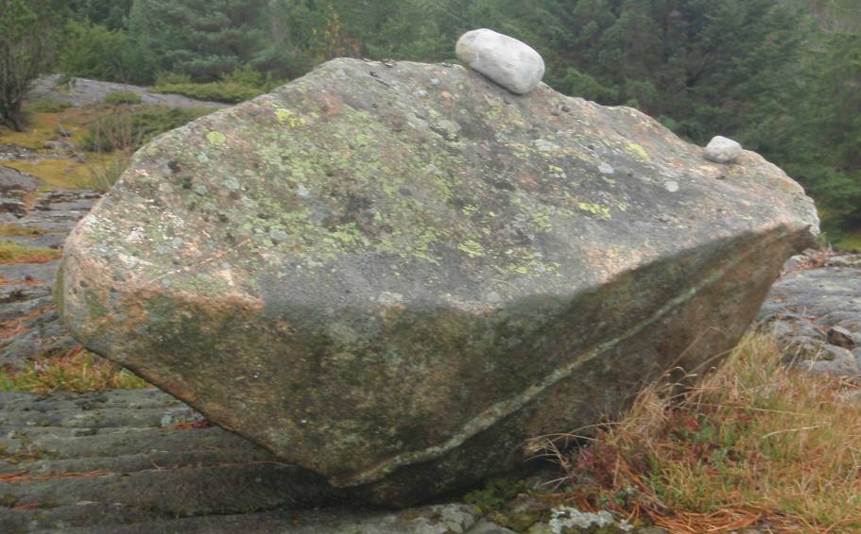
But what is a Sørlandsbanen anyway?
Lunde

Slide 14
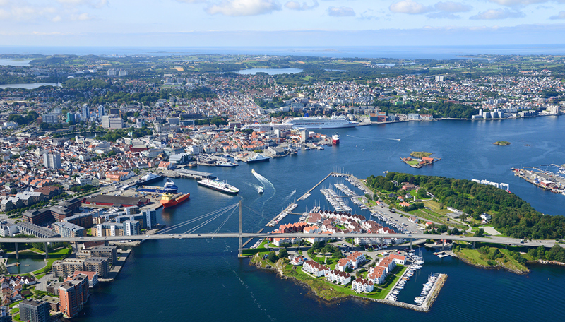
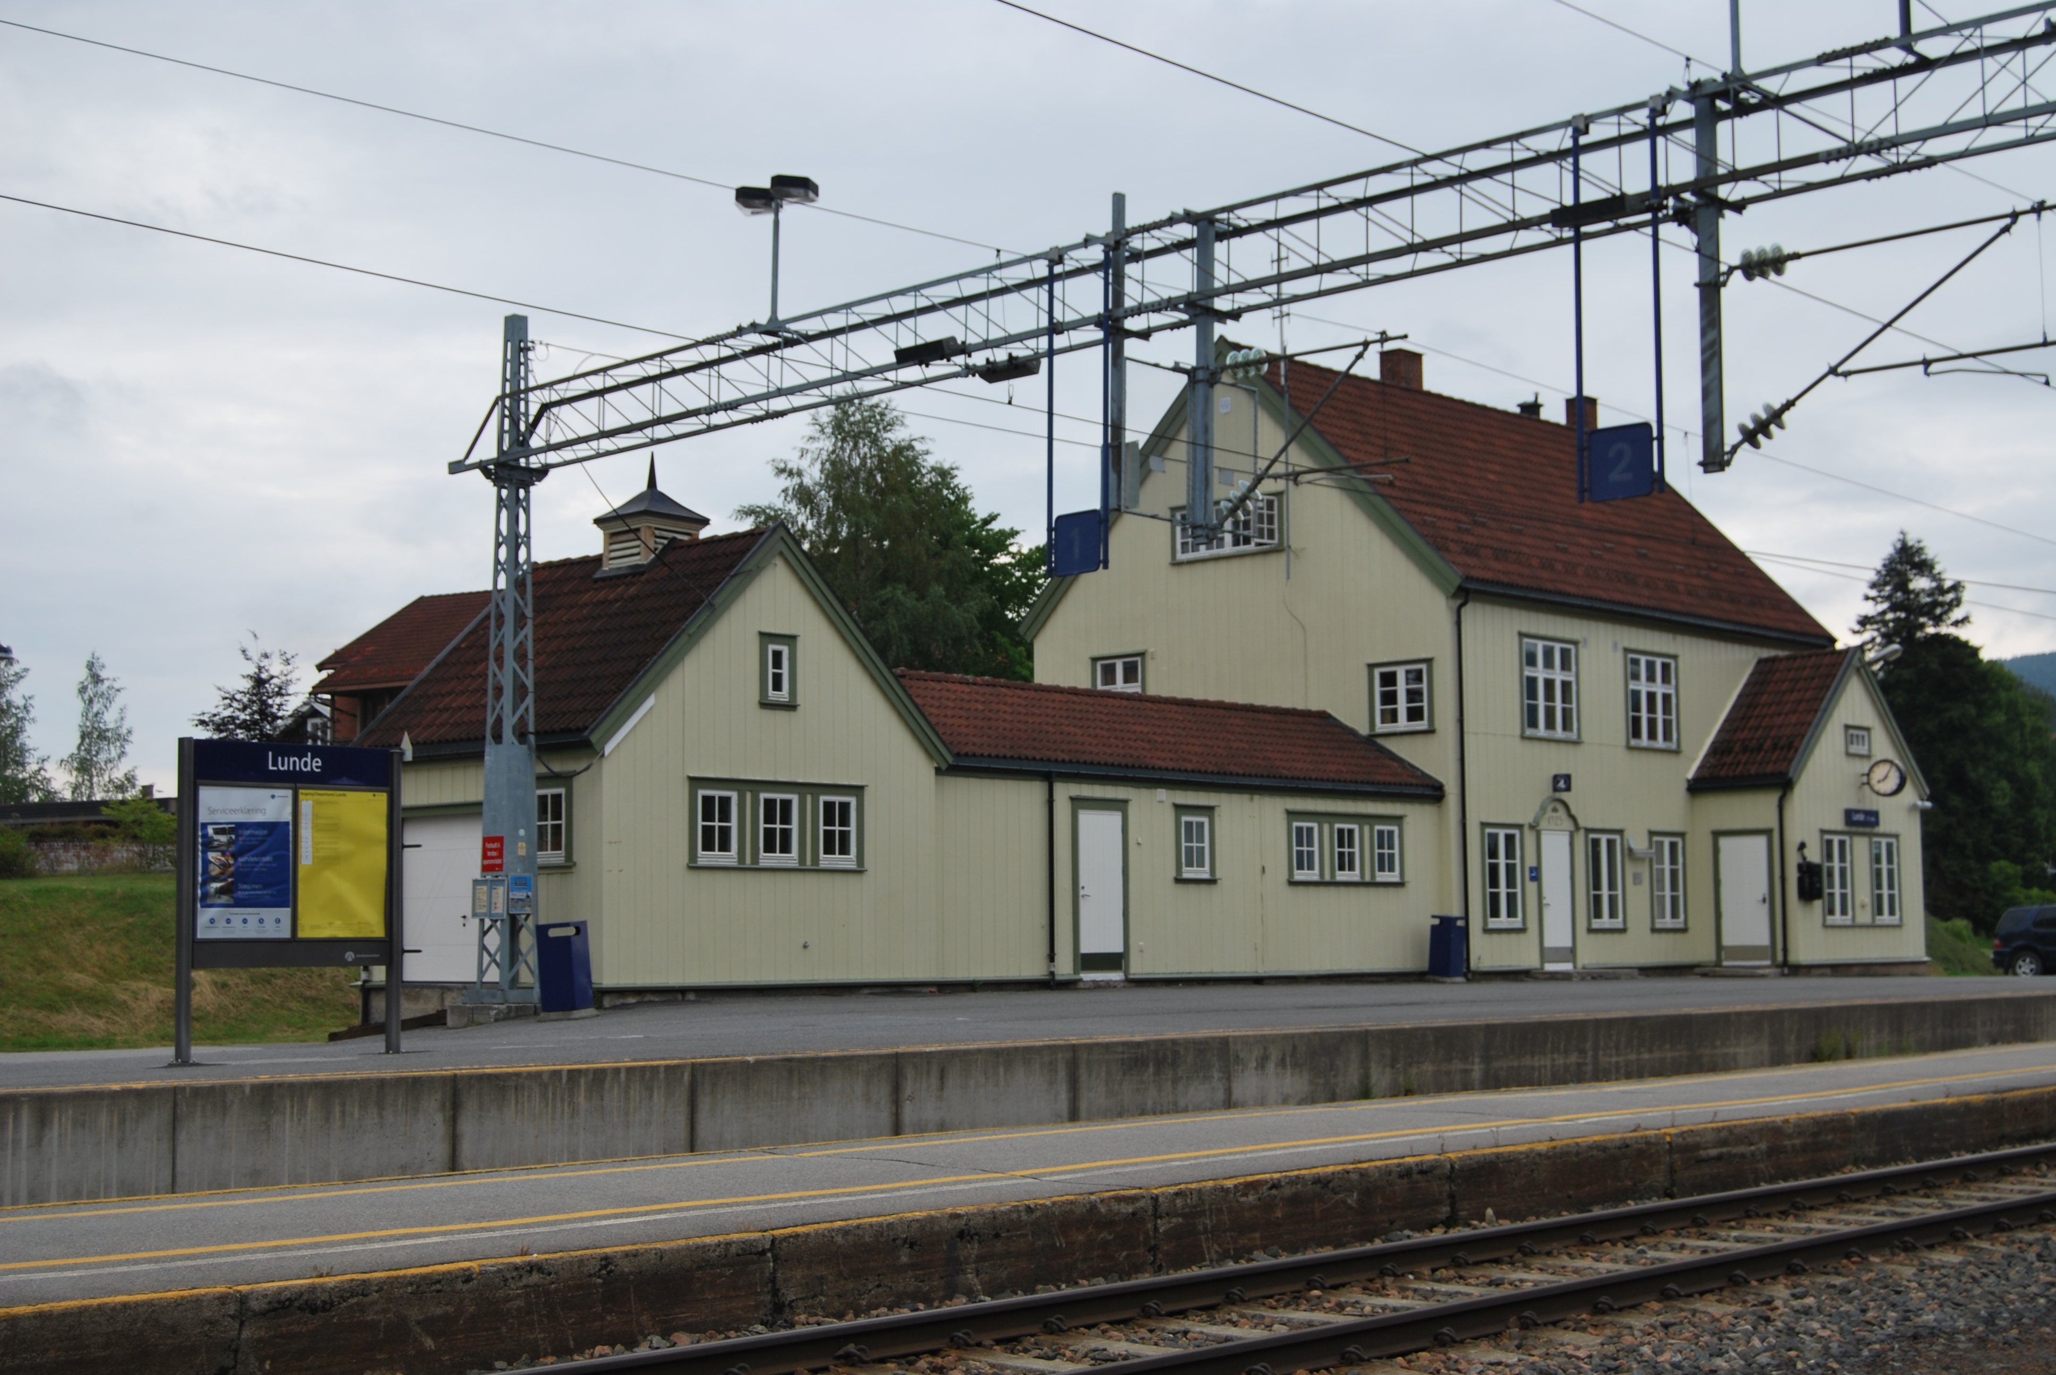
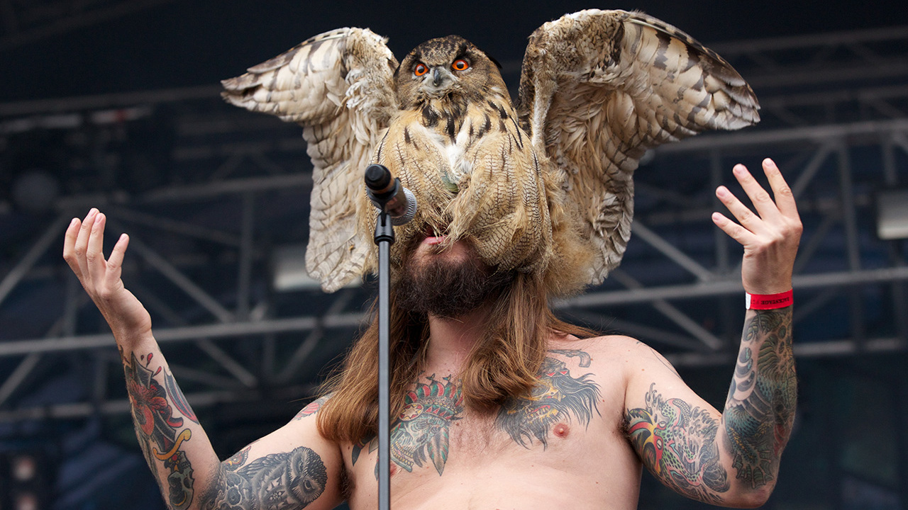
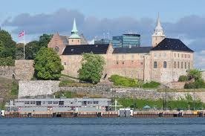
But what is a Sørlandsbanen anyway?
Lunde

Slide 15
The power of types

Slide 16
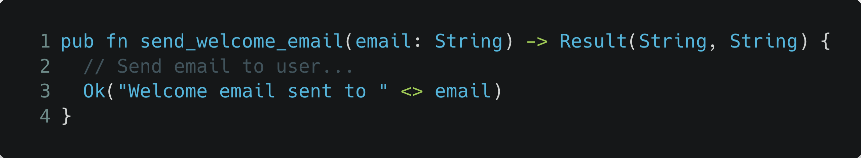
The power of types

Slide 17
The power of types
Is this a valid email?

Slide 18
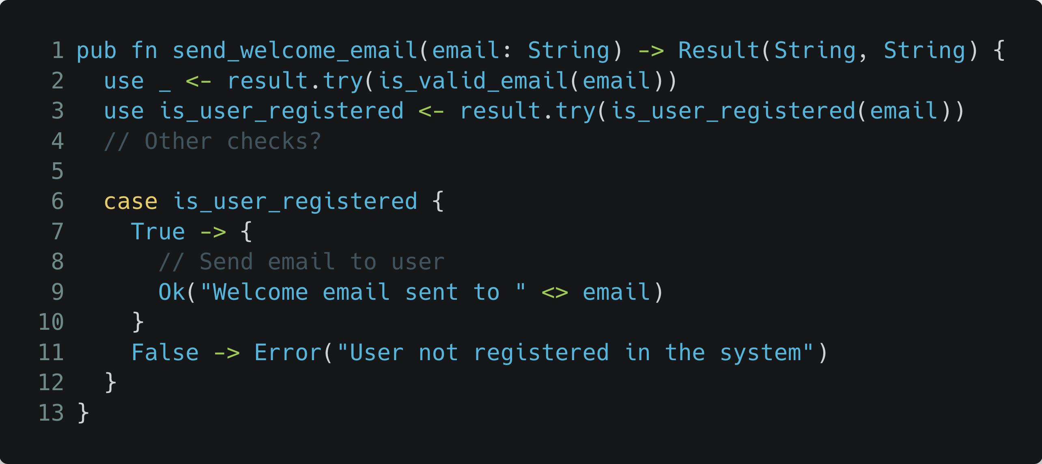
The power of types

Slide 19
The power of types
Dependencies and tight coupling

Slide 20
The power of types
Validation failure
Communication failure

Slide 21
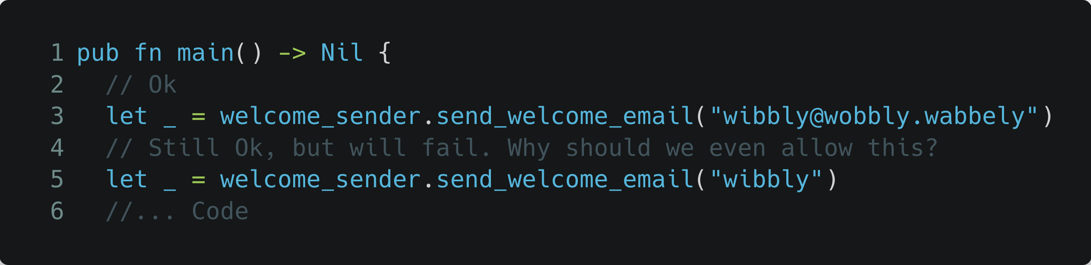
The power of types

Slide 22
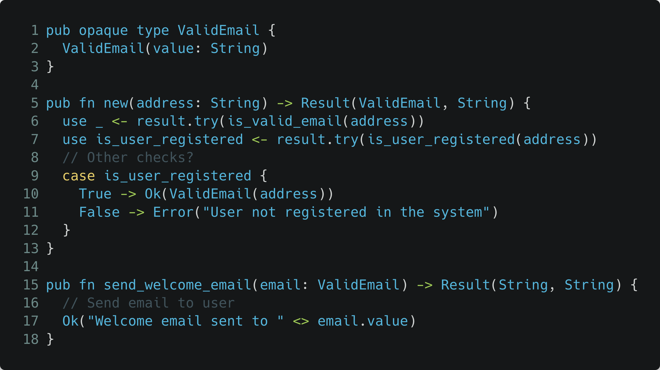
The power of types

Slide 23
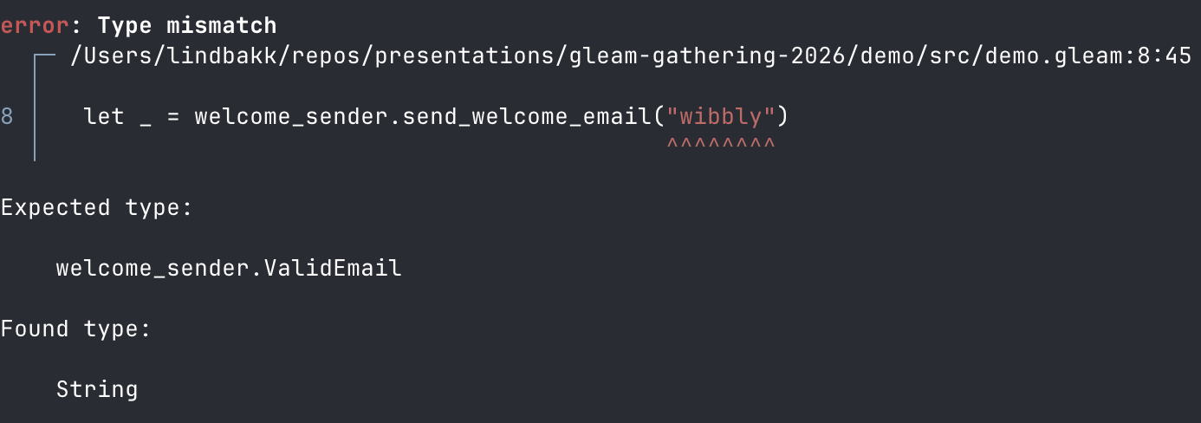
The power of types

Slide 24
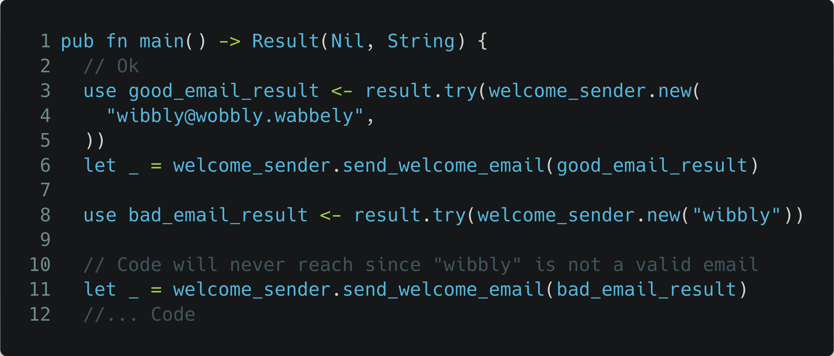
The power of types

Slide 25
The power of types

Slide 26

The power of types
email_validator.gleam
welcome_sender.gleam

Slide 27
The power of types
email_validator.gleam
welcome_sender.gleam
newsletter_sender.gleam
dark_pattern_sender.gleam

Slide 28
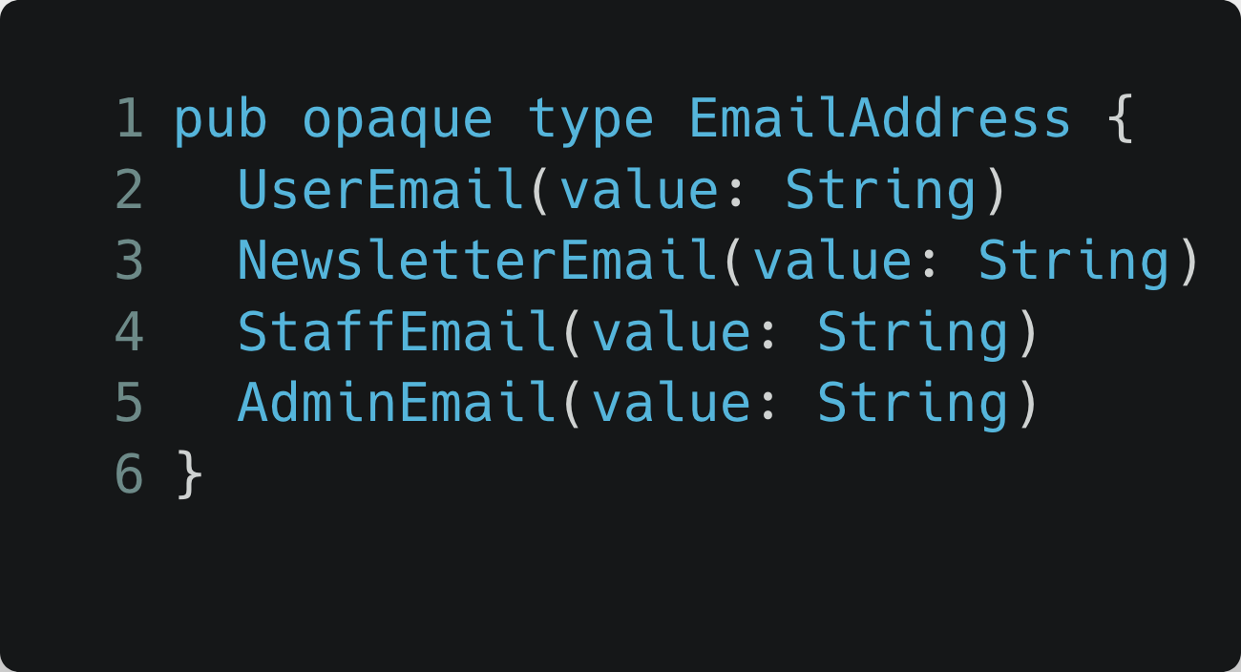
The power of types
Web API
email_validator.gleam
Batch jobs
welcome_sender.gleam
Other?
newsletter_sender.gleam
dark_pattern_sender.gleam
All forced to validate!

Slide 29
The power of types
Web API
“Make Illegal States Unrepre­sentable”
email_validator.gleam
- Yaron Minsky
Batch jobs
welcome_sender.gleam
Other?
newsletter_sender.gleam
dark_pattern_sender.gleam
All forced to validate!

Slide 30
The power of types
Web API
“Make Illegal States Unrepre­sentable”
email_validator.gleam
- Yaron Minsky
Batch jobs
welcome_sender.gleam
Other?
newsletter_sender.gleam
dark_pattern_sender.gleam
All forced to validate!

